Slide 1

MODULE-4
PIPELINING

Slide 2

WHY PIPELINING IS NEEDED?
To improve the performance of a CPU we have two options:
1) Improve the hardware by introducing faster circuits.
2) Arrange the hardware such that more than one operation can be performed at the same time.
Since there is a limit on the speed of hardware and the cost of faster circuits is quite high, we must adopt the 2nd option, i.e., Pipelining.

Slide 3
What is Pipelining
Pipelining is a technique for breaking down a sequential process into various sub-operations and executing each sub-operation in its own dedicated segment that runs in parallel with all other segments.
The most significant feature of a pipeline technique is that it allows several computations to run in parallel in different parts at the same time.
F D E | | | | | |
| | | F D E | | |
| | | | | | F D E (9 minutes)
(a) Without Pipelining (T = 9/3 = 3 min)
F D E | |
| F D E |
| | F D E (5 minutes)
(b) With Pipelining (T = 5/3 = 1.67 min)

Slide 4
Advantages of Pipelining
Cycle time of the processor is decreased.
Instruction throughput increases.
Increase in the number of pipeline stages increases the number of instructions executed simultaneously.
Faster ALU can be designed when pipelining is used.
Pipelined CPU’s works at higher clock frequencies than the RAM.
Pipelining increases the overall performance of the CPU.

Slide 5
Disadvantages of Pipelining
Designing of the pipelined processor is complex.
Instruction latency increases in pipelined processors.
The throughput of a pipelined processor is difficult to predict.
The longer the pipeline, worse the problem of hazard for branch instructions.

Slide 6
Types of Pipelining
Arithmetic Pipeline – An arithmetic pipeline separates a given arithmetic problem into subproblems that can be executed in different pipeline segments. It’s used for multiplication, floating-point operations, and a variety of other calculations.
Instruction Pipeline – An instruction pipeline receives sequential instructions from memory while prior instructions are implemented in other portions. Pipeline processing can be seen in both the data and instruction streams

Slide 7
Arithmetic Pipeline
Arithmetic Pipelines are mostly used in high-speed computers.
They are used to implement floating-point operations, multiplication of fixed-point numbers, and similar computations encountered in scientific problems.
An arithmetic pipeline divides an arithmetic problem into various sub problems for execution in various pipeline segments.

Slide 8
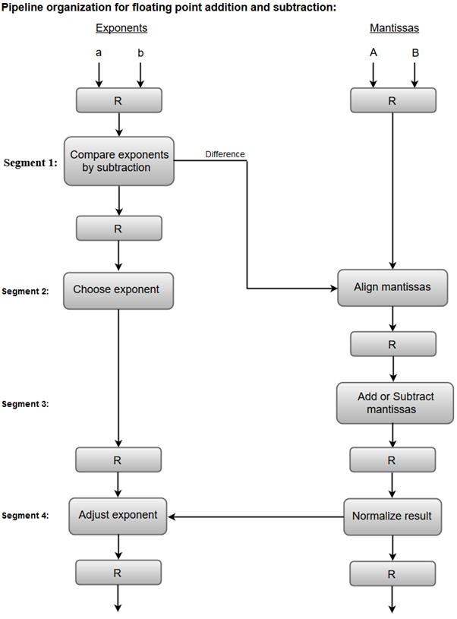

Arithmetic Pipeline
1. Compare exponents by subtraction:
The exponents are compared by subtracting them to determine their difference. The larger exponent is chosen as the exponent of the result.
The difference of the exponents, i.e., 3 - 2 = 1 determines how many times the mantissa associated with the smaller exponent must be shifted to the right.
2. Align the mantissas:
The mantissa associated with the smaller exponent is shifted according to the difference of exponents determined in segment one.

Slide 9


Arithmetic Pipeline
3. Add mantissas:
The two mantissas are added in segment three
4. Normalize the result:
After normalization, the result is written as:
.

Slide 10
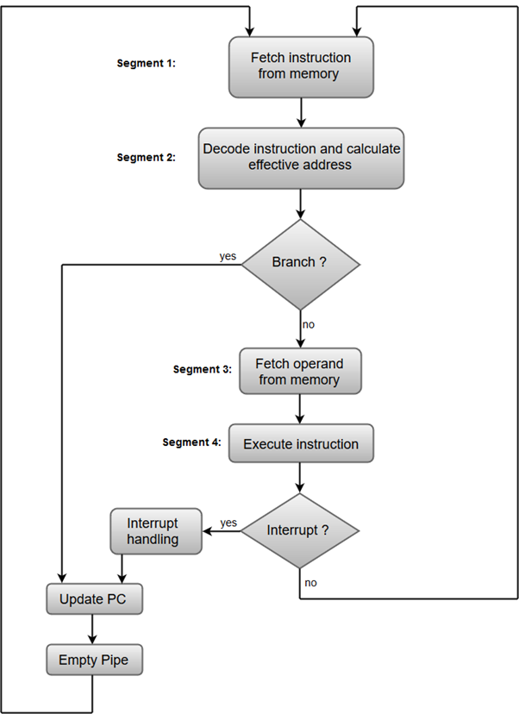
Instruction Pipeline
In this a stream of instructions can be executed by overlapping fetch, decode and execute phases of an instruction cycle.
This type of technique is used to increase the throughput of the computer system.
An instruction pipeline reads instruction from the memory while previous instructions are being executed in other segments of the pipeline. Thus, we can execute multiple instructions simultaneously.
The pipeline will be more efficient if the instruction cycle is divided into segments of equal duration.

Slide 11
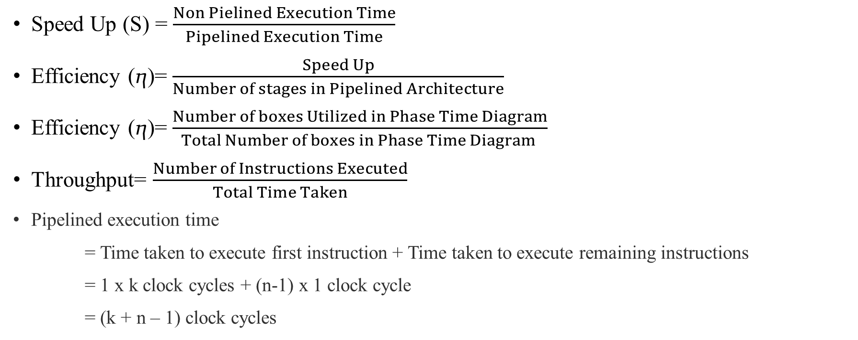
Formulas based on Pipelining
Speed Up (S) = $\frac{Non Pielined Execution Time}{Pipelined Execution Time}$
Efficiency (ⴄ)= $\frac{Speed Up}{Number of stages in Pipelined Architecture}$
Efficiency (ⴄ)= $\frac{Number of boxes Utilized in Phase Time Diagram}{Total Number of boxes in Phase Time Diagram }$
Throughput= $\frac{Number of Instructions Executed}{Total Time Taken}$
Pipelined execution time
= Time taken to execute first instruction + Time taken to execute remaining instructions
= 1 x k clock cycles + (n-1) x 1 clock cycle
= (k + n – 1) clock cycles

Slide 12
Important Parameters of Pipelined Architecture.
Case-01: All the stages offer same delay-
If all the stages offer same delay, then-
Cycle time = Delay offered by one stage including the delay due to its register
Case-02: All the stages do not offer same delay-
If all the stages do not offer same delay, then-
Cycle time = Maximum delay offered by any stage including the delay due to its register
Point-02: Calculating Frequency Of Clock-
Frequency of the clock (f) = 1/Cycle time

Slide 13
Important Parameters of Non-pipelined Architecture.
Non-pipelined execution time = Total number of instructions x Time taken to execute one instruction = n x k clock cycles

Slide 14
Numericals (https://www.gatevidyalay.com/pipelining-practice-problems/)
Question 1: Consider a pipeline having 4 phases with duration 60, 50, 90 and 80 ns. Given latch delay is 10 ns. Calculate-
Pipeline cycle time
Non-pipeline execution time
Speed up ratio
Pipeline time for 1000 tasks
Sequential time for 1000 tasks
Throughput

Slide 15
Numericals
Question 2: A non-pipelined single cycle processor operating at 100 MHz is converted into a synchronous pipelined processor with five stages requiring 2.5 ns, 1.5 ns, 2 ns, 1.5 ns and 2.5 ns respectively. The delay of the latches is 0.5 sec. The speed up of the pipeline processor for a large number of instructions is-
1) 4.5
2) 4.0
3) 3.33
4) 3.0

Slide 16
Numericals

Slide 17
Numerical (Contd..)
Question 4: A four-stage pipeline has the stage delays as 150, 120, 160 and 140 ns respectively. Registers are used between the stages and have a delay of 5 ns each. Assuming constant clocking rate, the total time taken to process 1000 data items on the pipeline will be-
120.4 microseconds
160.5 microseconds
165.5 microseconds
590.0 microseconds

Slide 18
Numerical (Contd..)
Question 4: Consider a non-pipelined processor with a clock rate of 2.5 gigahertz and average cycles per instruction of 4. The same processor is upgraded to a pipelined processor with five stages but due to the internal pipeline delay, the clock speed is reduced to 2 gigahertz. Assume there are no stalls in the pipeline. The speed up achieved in this pipelined processor is-
1) 3.2
2) 3.0
3) 2.2
4) 2.0

Slide 19
Numerical (Contd..)
Question 5: The stage delays in a 4-stage pipeline are 800, 500, 400 and 300 picoseconds. The first stage is replaced with a functionally equivalent design involving two stages with respective delays 600 and 350 picoseconds. The throughput increase of the pipeline is _____%.

Slide 20
Numericals
Question 6: Consider a pipelined processor with the following four stages:
IF: Instruction Fetch
ID: Instruction Decode and Operand Fetch
EX: Execute
WB: Write Back
The IF, ID and WB stages take one clock cycle each to complete the operation. The number of clock cycles for the EX-stage depends on the instruction. The ADD and SUB instructions need 1 clock cycle and the MUL instruction needs 3 clock cycles in the EX-stage. Operand forwarding is used in the pipelined processor. What is the number of clock cycles taken to complete the following sequence of instructions?
ADD R2, R1, R0 R2 <- R0 + R1
MUL R4, R3, R2 R4 <- R3 * R2
SUB R6, R5, R4 R6 <- R5 - R4

Slide 21
Imagine a pipeline system that has four stages: instruction fetch (IF), instruction decodes (ID), execution (EX) and write back (WB). The following table illustrates the number of clock cycles needed for each instruction to finish each stage. Calculate the number of clock cycles required to complete the instructions?
Instructions | Instruction Fetch (IF) | Instruction Decode (ID) | Execution (EX) | Write Back (WB)
I₀ | 2 | 1 | 2 | 1
I₁ | 2 | 2 | 3 | 1
I₂ | 1 | 2 | 1 | 2
I₃ | 2 | 3 | 2 | 1
I₄ | 3 | 1 | 1 | 2

